Slide 1
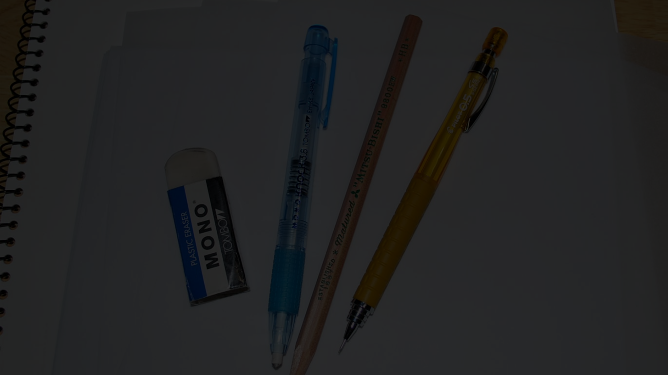
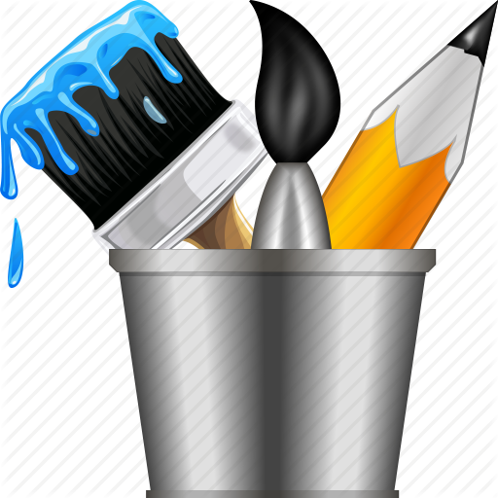
Welcome to the Drawing Tool!
We're excited to share
our drawing software with you.
Our tool makes it
easy to create drawings, whether you're an artist, engineer, or hobbyist.
With a wide range of tools
and features,
you'll be able to bring your
ideas to life in no time.
Let's get started!

Slide 2
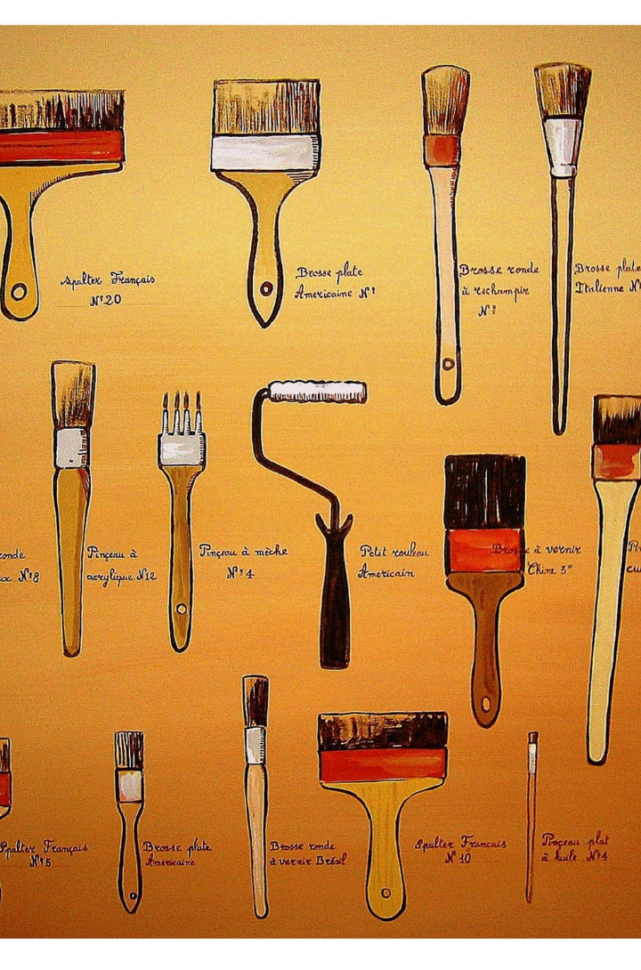
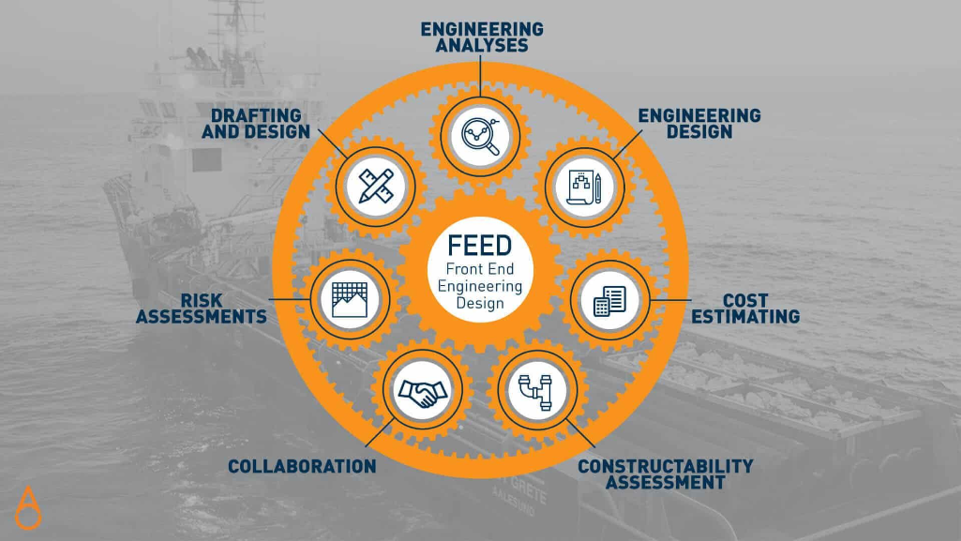
Front End Engineering Project-1 : A Drawing Tool
Welcome to our Front End Engineering-I project. Our team, led by our talented faculty coordinator, has helped us to develop an innovative drawing tool. We are thrilled to showcase our work.

Slide 3

Meet Our Team:
Get to know the amazing people:
ARCHI
ARIHANT JAIN
ARMAN KALRA
Meet Our Dedicated Faculty Coordinator:
Dr. Chetna Kaushal
Dr. Amandeep Kaur

Slide 4

Brief Introduction of the Drawing Tool
The Drawing Tool is a powerful software application for creating stunning visuals and animations. With our user-friendly interface you can focus on your creativity. Learn more about the Drawing Tool and how it can help you achieve your creative goals.

Slide 5
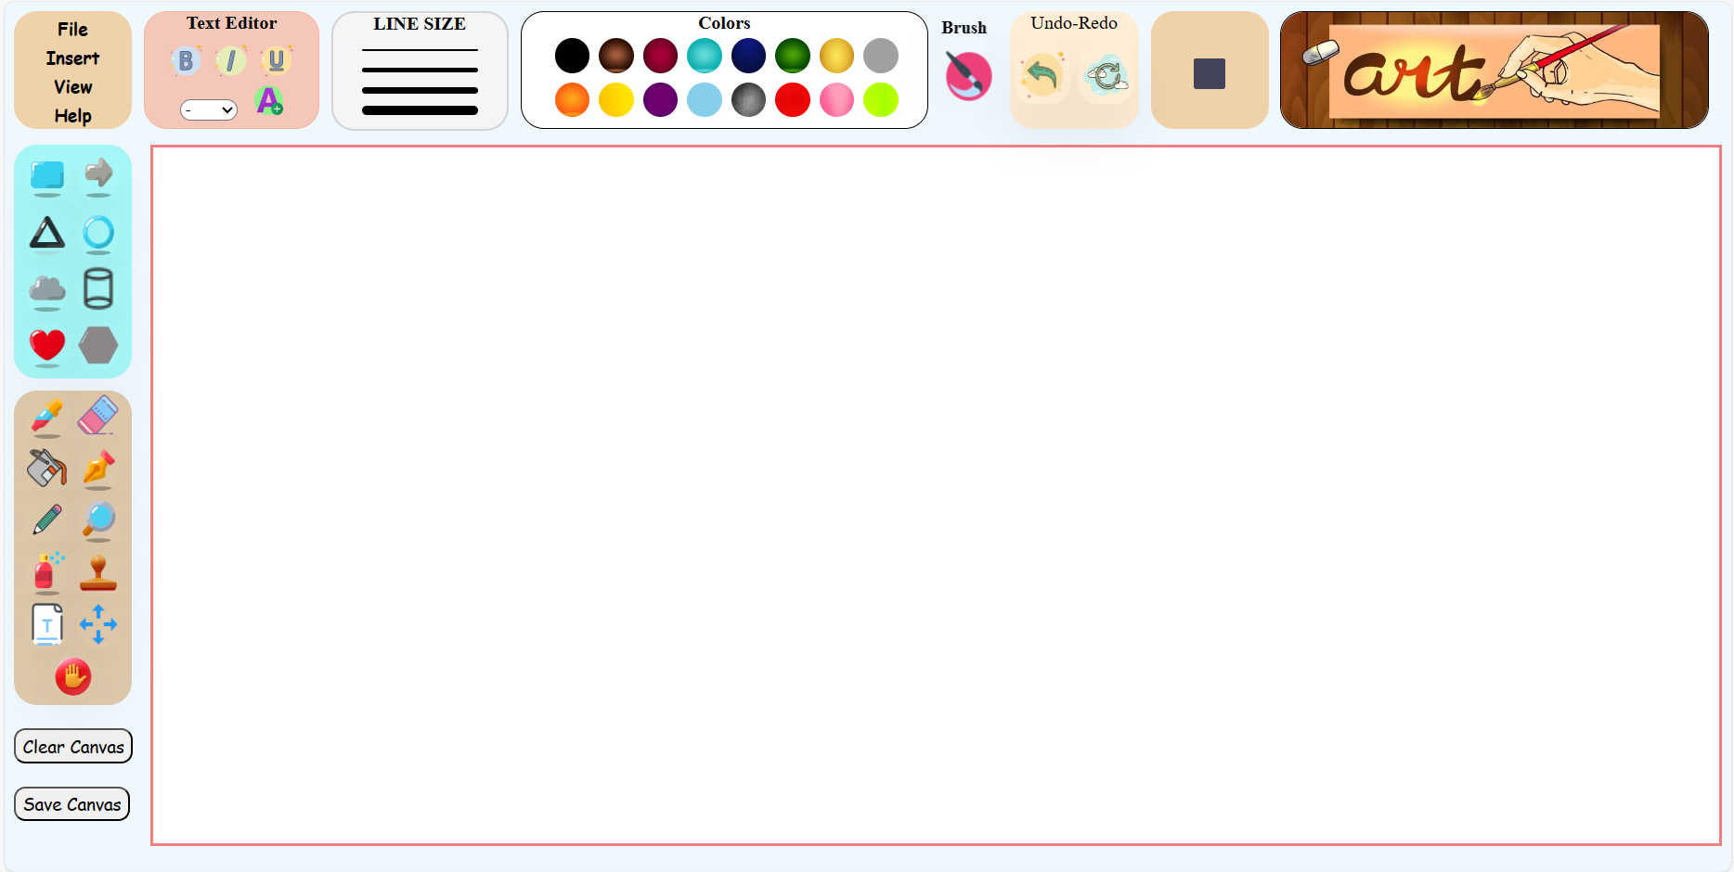

Slide 6



Technical Details
Our drawing tool utilizes advanced algorithms and precise rendering techniques
to deliver smooth and accurate lines.
With support for various brush types, layer management,
and customizable settings, you'll have full control over your creations.
Experience the power of our drawing tool today!

Slide 7
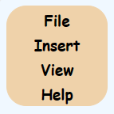
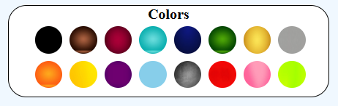
<div id="firstbox">
<button class="buttonfirstbox">File</button><br />
<button class="buttonfirstbox">Insert</button><br />
<button class="buttonfirstbox">View</button><br />
<button class="buttonfirstbox">Help</button><br />
</div>
<div id="colors">
<b> Colors </b><br>
<img class="colorimages" id="black" src="black.jpg" alt="black">
<img class="colorimages" id="brown" src="brown.jpg" alt="brown">
<img class="colorimages" id="crimson" src="crimson.jpg" alt="crimson">
<img class="colorimages" id="cyan" src="cyan.jpg" alt="cyan">
<img class="colorimages" id="dark blue" src="dark blue.jpg" alt="dark blue">
<img class="colorimages" id="dark green" src="dark green.jpg" alt="dark green">
<img class="colorimages" id="gold" src="gold.jpg" alt="gold">
<img class="colorimages" id="grey" src="grey.jpeg" alt="grey"> <br>
<img class="colorimages" id="orange" src="orange.jpg" alt="orange">
<img class="colorimages" id="yellow" src="yellow.jpg" alt="yellow">
<img class="colorimages" id="vilot" src="vilot.jpg" alt="vilot">
<img class="colorimages" id="sky blue" src="sky blue.jpeg" alt="sky blue">
<img class="colorimages" id="silver" src="silver.jpg" alt="silver">
<img class="colorimages" id="red" src="red.jpg" alt="red">
<img class="colorimages" id="pink" src="pink.jpg" alt="pink">
<img class="colorimages" id="parrot" src="parrot.jpg" alt="parrot">
</div>
#firstbox {
width: 100px;
height: 100px;
text-align: center;
border: 1px solid rgb(239, 210, 170);
border-radius: 20px;
background-color: rgb(239, 210, 170);
}
.buttonfirstbox {
width: 70px;
border: none;
background-color: rgb(239, 210, 170);
font-size: 15px;
font-family: cursive;
text-align: center;
font-weight: bold;
border-radius: 10px;
margin-top: 2px;
}
#colors {
border: 1px solid black;
width: 350px;
height: 100px;
text-align: center;
border-radius: 20px;
background-color: white;
}
.colorimages {
width: 30px;
height: 30px;
margin-top: 4px;
margin-left: 4px;
border-radius: 50px; }

Slide 8
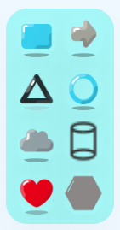
<div id="shapes">
<img class="shapeicons" id="square" src=“ICONS/icons8-square-64.png" alt="Square" />
<img class="shapeicons" id="arrow" src=" ICONS/icons8-arrow-64.png" alt="Arrow" />
<img class="shapeicons" id="triangle" src=" ICONS/icons8-triangle-64.png" alt="triangle" />
<img class="shapeicons" id="circle" src=" ICONS/icons8-circle-64.png" alt="circle"/>
<img class="shapeicons" id="cloud" src=" ICONS/icons8-cloud-64.png" alt="cloud" />
<img class="shapeicons" id="cylinder" src=" ICONS/icons8-cylinder-24.png" alt="cylinder"/>
<img class="shapeicons" id="hear" src=" ICONS/icons8-heart-64.png" alt="heart" />
<img class="shapeicons" id="hexagon" src=" ICONS/icons8-hexagon-64.png" alt="hexagon" />
</div>
#shapes {
border: 1px solid rgb(166, 247, 247);
width: 100px;
height: 200px;
margin-top: 10PX;
text-align: center;
border-radius: 20px;
background-color: rgb(166, 247, 247);
}
.shapeicons {
width: 40px;
height: 40px;
margin-top: 5px;
transform: perspective(1500px) rotateY(20deg);
border-radius: 1rem;
box-shadow: rgba(0, 0, 0, 0.25) 0px 25px 50px -12px;
transition: transform 1s ease 0s;
&:hover {
transform: perspective(3000px) rotateY(5deg);
}
}

Slide 9
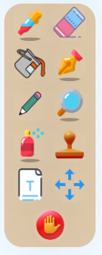
<div id="painttools">
<img class="iconpainttool" id="color-picker" src=" ICONS/icons8-color-picker-64.png" alt="color-picker">
<img class="iconpainttool" id="eraser" src=" ICONS/icons8-eraser-64.png" alt="eraser">
<img class="iconpainttool" id="fill-color" src=" ICONS/icons8-fill-color-48.png" alt="fill-color">
<img class="iconpainttool" id="pen" src=" ICONS/icons8-pen-64.png" alt="pen">
<img class="iconpainttool" id="pencil" src=" ICONS/icons8-pencil-100.png" alt="pencil">
<img class="iconpainttool" id="magnifying-glass" src=" ICONS/icons8-magnifying-glass-64.png" alt="magnifying-glass">
<img class="iconpainttool" id="spray-can" src=" ICONS/icons8-spray-can-64.png" alt="spray-can">
<img class="iconpainttool" id="stamp" src=" ICONS/icons8-stamp-94.png" alt="stamp">
<img class="iconpainttool" id="type" src=" ICONS/icons8-type-64.png" alt="type">
<img class="iconpainttool" id="move" src=" ICONS/icons8-move-48.png" alt="move">
<img class="iconpainttool" id="hand" src=" ICONS/icons8-hand-94.png" alt="hand">
</div>
#painttools {
border: 1px solid rgb(223, 201, 171);
width: 100px;
height: 270px;
margin-top: 10PX;
text-align: center;
border-radius: 20px;
background-color: rgb(223, 201, 171);
}
.iconpainttool {
width: 40px;
height: 40px;
margin-top: 1px;
transform: perspective(1500px) rotateY(20deg);
border-radius: 1rem;
box-shadow: rgba(0, 0, 0, 0.25) 0px 25px 50px -12px;
transition: transform 1s ease 0s;
&:hover {
transform: perspective(3000px) rotateY(5deg);
}
}

Slide 10

Project Purpose and Goals
Our Drawing Tool project is aimed at providing a platform for creating visualizations.
Easy to use and understand.
We are committed to making it the best possible tool for our users.
We aim to provide users with an enjoyable and engaging experience while making high-quality drawings.

Slide 11

Problem Solving
Sketching: the Visual Thinking Power
GIVE SKETCHING A TEST RUN
A collection of tools
New and friendly interface
Easy to use
Go and sketch!

Slide 12
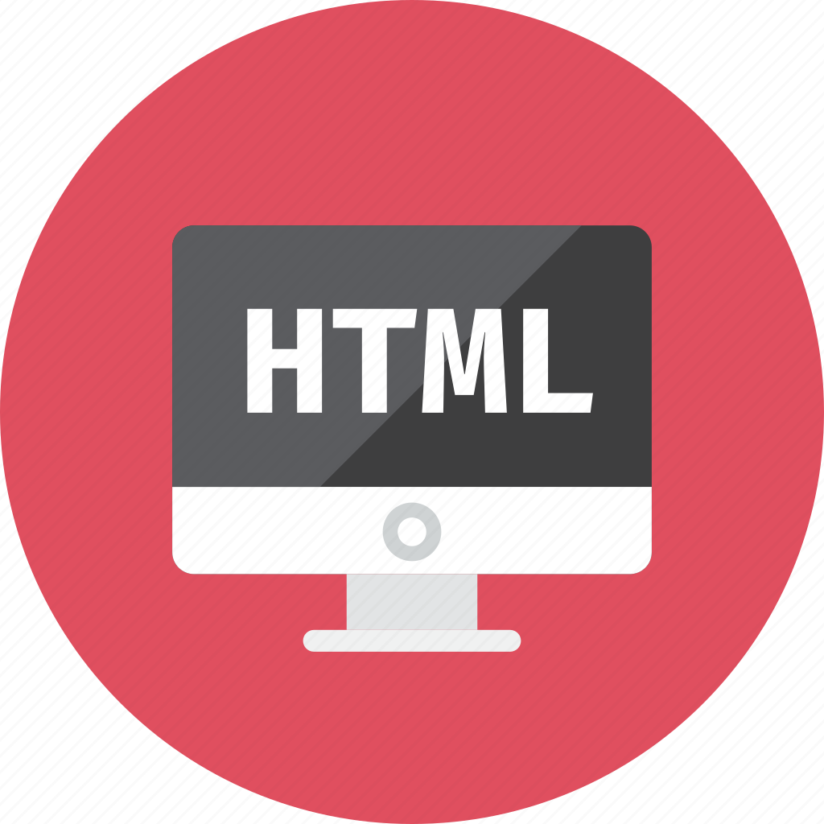


Technologies and Methods Used
1
HTML5
We used HTML5 for the backbone of our project.
2
CSS3
CSS3 was used to style and animate the tool.
3
JAVASCRIPT
JAVASCRIPT was used to add functionality in our project.

Slide 13


Key Features for Drawing Tool
Our Drawing Tool is designed to meet the needs of creators of all types, from beginner to professional.
Key features include a user-friendly interface, powerful animation and visualization tools, and the ability to export to multiple file formats.
We are also constantly working to add new features and improve the user experience.

Slide 14
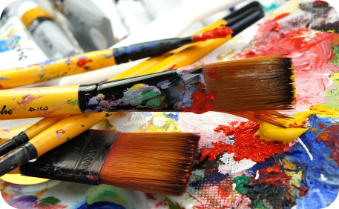

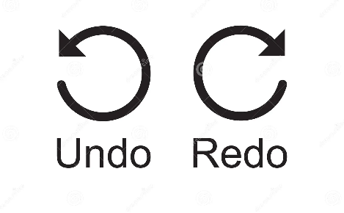
Capabilities
Brushes and Colors
Color Mixing
Undo and Redo
Select from a variety of brushes and colors to create beautiful artwork.
Easily mix colors and create your own unique palettes with our intuitive color wheel tool.
Never lose anything again comprehensive undo/redo feature.

Slide 15



Sources and References
W3Schools
YouTube
Online research:
HTML, CSS, and JS documentation
Tutorials for animating drawings
Inspiration and research for color schemes and brush styles

Slide 16

The Complete Picture and Next Steps
We have created an innovative tool that offers a wide range of powerful animation tools. Our next steps include further development to make it even better. Thank you for joining us on this journey!
Make it more better
Adding more tools and things

Slide 17

Conclusion
This project helps to
gain a great experience with team members.
With passage of time we came
across so many references
which helps us to enhance the quality of this project.

Slide 18


Thank You for Exploring the Drawing Tool
We appreciate your time and interest in learning more about the Drawing Tool.
Happy creating!

